Slide 1
A Semantic Tool for the Protection of Personal Information Act
Author: Yahlieel Jafta
2858132@myuwc.ac.za
Supervisor: Professor Louise Leenen
lleenen@uwc.ac.za
Co-Supervisor: Peter Chan (CSIR)
kchan@csir.co.za

Slide 2
Overview
Project Overview
Related Work
Implementation
Evaluation
Prototype Demo
Questions

Slide 3
Project Overview
The Act affects individuals and organizations
Establish a knowledge base to assist in interpretation of the Act
Establish knowledge base by building an ontology

Slide 4
Project Overview
What is an Ontology?
A formal representation of the knowledge by a set of concepts within a domain and the relationships between those concepts [5].
Enables machines and people to decipher the meaning of concepts unambiguously.
Enables the extension of knowledge of a given domain through inference.

Slide 5
Why an Ontology?
Ontologies vs Relational Databases
Databases has closed world assumption, Ontologies has open world assumption.
You can infer implicit information from ontologies, in databases you can't.
e.g. Joe is a student of “UWC”. Is Joe a student of “UCT”?
Database: No
Ontology: Don’t know
e.g. Fact: A student can only belong to one University
Joe is a student of “UWC”. Joe is also a student of “UCT”.
Database: Produces an error due to violation of fact.
Ontology: Infers that “UWC” and “UCT” is the same University.

Slide 6
Successful Ontology Implementations
Gene Ontology (GO)
Structured vocabularies for specific biological domains [6].
Knowledge base of terms relating to various organisms, consumed by several databases to explain genes and gene products unambiguously [6].
Protein Ontology (PO)
Efficiently represent the protein annotation framework.
Integrates existing data representations into a standardized protein data specification for the bio-informatics community [7].

Slide 7
Related Work
GDPR Ontology [8]
Models data protection requirements.
PrOnto Ontology [9]
A privacy ontology that conceptualizes the main concepts of the GDPR.
Support for data controllers in achieving compliance with the GDPR legislation.
Assist with legal thinking and compliance verification.

Slide 8
Methodology
METHONTOLOGY [1]
Specification, Conceptualization, Formalization, Implementation, Maintenance
Ontology Development 101: A Guide to Creating Your First Ontology [3]
Define Scope, Reuse Existing Ontologies, Enumerate Terms, Create Classes, Create Properties, Create Features

Slide 9
Scope
Competency Questions
What are the rights of data subjects?
Who is responsible of the responsible party?
What is considered personal information?

Slide 10
Development Tools

Slide 11
Implementation
Terms [2]
data subject means the person to whom personal information relates
A data subject have the right to have his, her or its personal information processed in accordance with the lawful conditions, including the right to -
Request to deletion of personal information.
To object to processing of personal information.
To submit a complaint to the Regulator
Gain access to personal information

Slide 12
Implementation
Base Classes | Subclasses
DataSubjectRight | RightToCorrection, RightToDeletion, RightToObject, RightToSubmitComplaint
DataSubjectAction | Access, Complain, Correction, Deletion, Objection
Person | DataSubject, Child, Operator, Regulator, ResponsibleParty
DataSubject | ChildDataSubject
PersonalInformation | SpecialPersonalInformation
Ontology Metrics
Axiom | 277
Logical axiom count | 147
Declaration axioms count | 84
Class count | 59
Object property count | 15
Data property count | 4
Individual count | 7
Annotation Property count | 2
SubClass of | 67
EquivalentClasses | 10
DisjointClasses | 11
Property | Domain | Range
exerciseRight | DataSubject | DataSubjectRight
hasInformation | DataSubject | PersonalInformation
mustEnsure | ResponsibleParty | LawfulCondition

Slide 13
Evaluation
Evaluation performed by ontology engineer Peter Chan (CSIR).
Question | Result | Feedback
Responsibility of role-players? | Results are to broad. | Simplify question and/or adjust query.
What is considered personal information? | Appropriate results returned.
How do organisations comply with Act? | Results are to broad. | Simplify question and/or adjust query.
Question | Result
What is the responsibility of the responsible party? | Appropriate results returned.
What are the rights of data subjects? | Appropriate results returned.

Slide 14
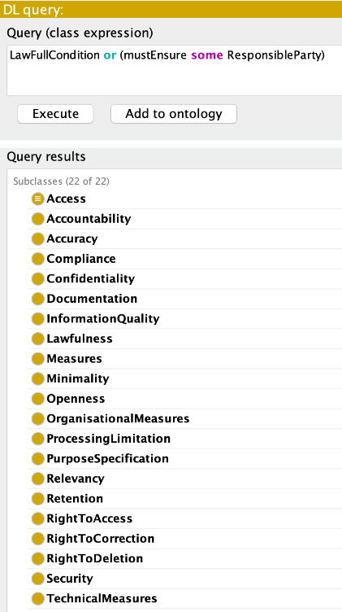
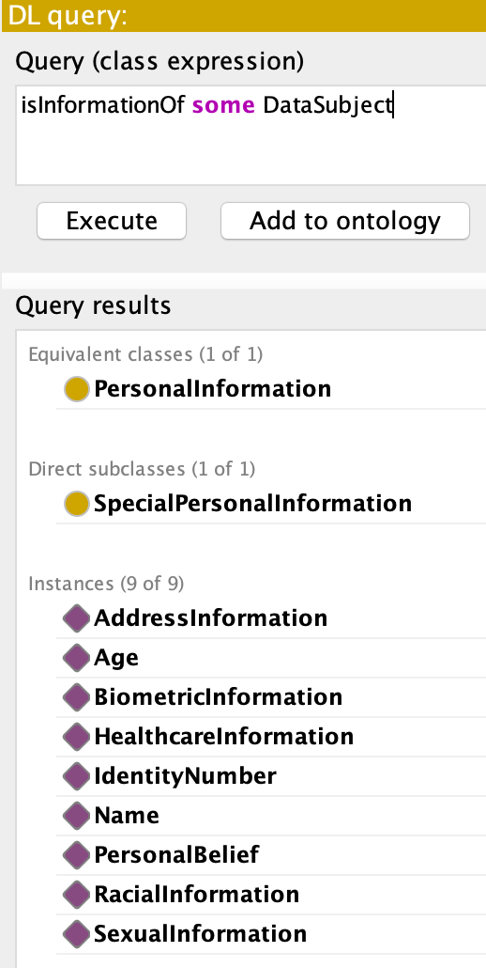
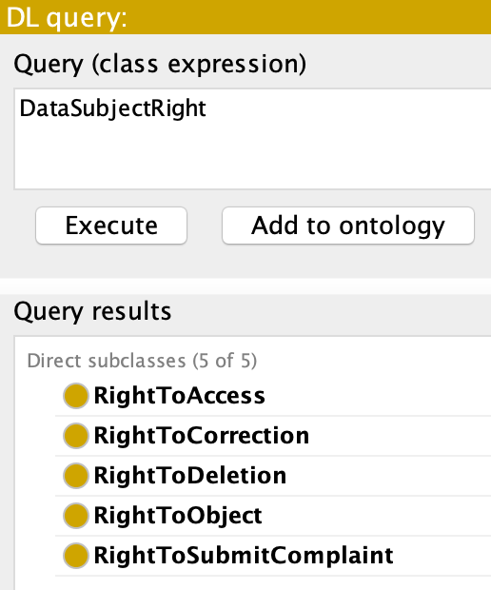

Slide 15
Conclusion and Future Work
Research demonstrates a proof of concept ontology on the POPIA.
Captures the essence of the Act.
Models the responsibilities of data processors.
Responsible Party compliance.
Data subjects and their rights.
Incorporate Legal Domain Expert.
Extend knowledge base.
Reuse existing ontologies.
Organization case study.

Slide 16
Southern Africa Telecommunication Networks and Applications Conference (SATNAC) 2019
Term 2 Work-in-progress paper accepted.
Poster Presentation.
SA Forum for Artificial Intelligence Research (FAIR) 2019
Term 3 Work-in-progress paper accepted .
Oral Presentation.

Slide 17
References
[1] M. Fernández-López, A. Gómez-Pérez, and N. Juristo. 1997. METHONTOLOGY: From Ontological Art Towards Ontological Engineering. In Proceedings of the Ontological Engineering AAAI-97 Spring Symposium Series. American Asociation for Artificial Intelligence. http://oa.upm.es/5484/ Ontology EngineeringGroup ? OEG.
[2] South African Government Gazette. 2013. Protection of Personal Information Act. http://www.justice.gov.za/legislation/acts/2013-004.pdf.
[3] N F. Noy and Deborah Mcguinness. 2001. Ontology Development 101: A Guide to Creating Your First Ontology. Knowledge Systems Laboratory 32 (01 2001).
[4] Horridge, Matthew and Jupp, Simon and Moulton, Georgina and Rector, Alan and Stevens, Robert. 2011. A Practical Guide To Building Owl Ontologies Using Protégé 4 and CO-ODE Tools Edition 1.3. The University of Manchester.
[5] Diana Man. 2013. Ontologies in Computer Science. Didactica Mathematica31 (2013), 43–46
[6] T. G. O. Consortium. 2001. Creating the Gene Ontology Resource: Design and Implementation. Genome Research11, 8 (Aug 2001), 1425-1433. https://doi.org/10.1101/gr.180801
[7] Amandeep Sidhu, Tharam S. Dillon, Elizabeth Chang, and Baldev S. Sidhu. 2005.Protein Ontology Development using OWL., Vol. 188
[8] Cesare Bartolini, Robert Muthuri, and Cristiana Santos. 2017. Using Ontologies toModel Data Protection Requirements in Workflows. InNew Frontiers in ArtificialIntelligence, Mihoko Otake, Setsuya Kurahashi, Yuiko Ota, Ken Satoh, and DaisukeBekki (Eds.). Springer International Publishing, 233– 248
[9] Monica Palmirani, Michele Martoni, Arianna Rossi, Cesare Bartolini, and LivioRobaldo. 2018.PrOnto: Privacy Ontology for Legal Reasoning: 7th International Con-ference, EGOVIS 2018, Regensburg, Germany, September 3-5, 2018, Proceedings.139–152.
https://doi.org/10.1007/978-3-319-98349-3_11

Slide 18
Thank You

